Slide 1
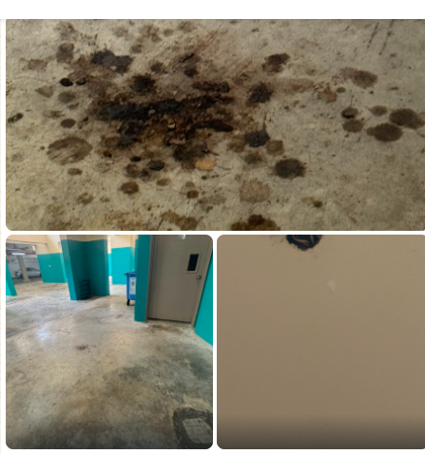
Cleaning Services -Briefing on Common Area cleaning and Do’s and Don’t’s
Council Feedback : Actually, can ask cleaners to hi jet & wash more B1 more regularly !
Some cleaners seems staying at their store even not tea breaks or lunch hours

Slide 2
Cleaning Services -Briefing on Common Area cleaning and Do’s and Don’t’s
Feedback from resident asking why some cleaners just busy with their hp during working hour
Feedback on the All-lobby area Railing dusty and dirty .

Slide 3
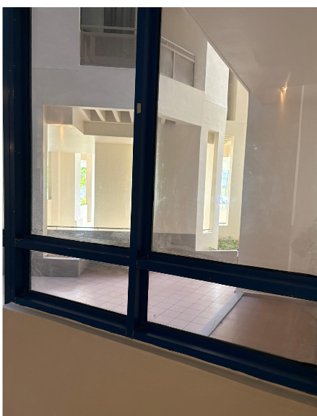
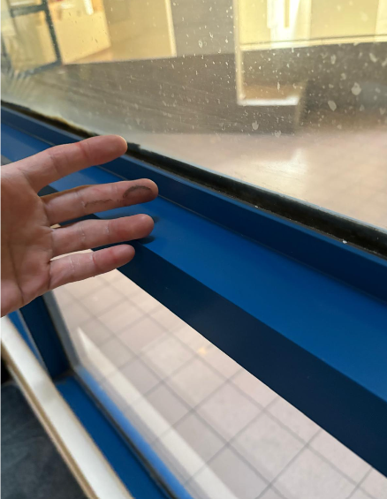
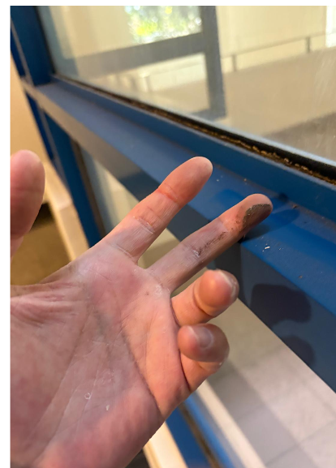
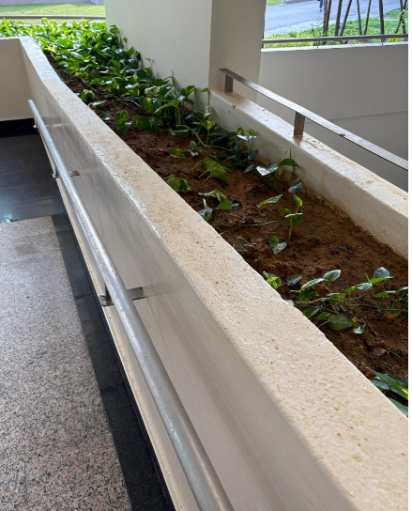
Cleaning Services -Briefing on Common Area cleaning and Do’s and Don’t’s

Slide 4
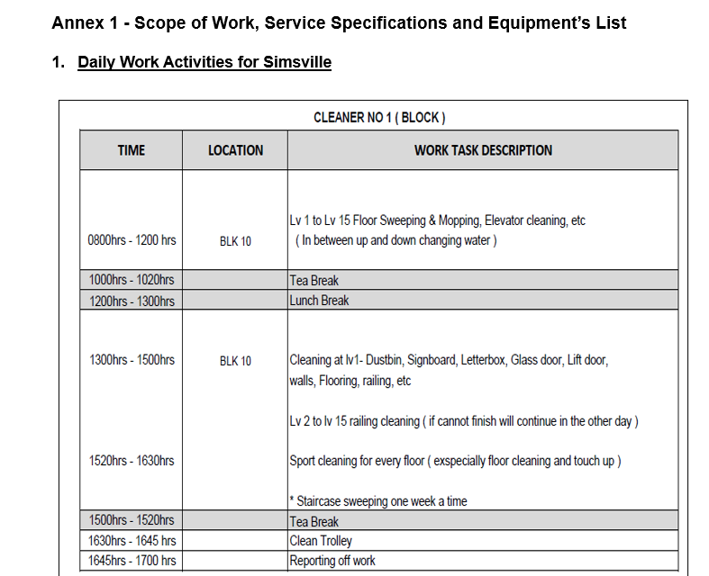
Cleaning Services -Briefing on Common Area cleaning and Do’s and Don’t’s

Slide 5
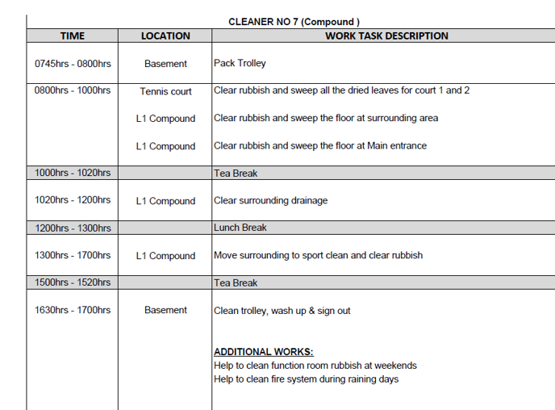
Cleaning Services -Briefing on Common Area cleaning - Do’s and Don’t’s

Slide 6
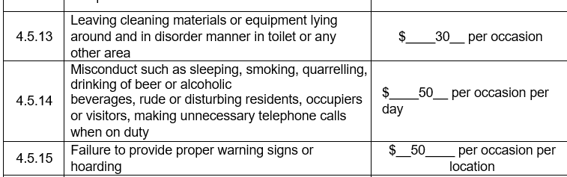

Cleaning Services -Briefing on Common Area cleaning and Do’s and Don’t’s

