Slide 1
Cyber Security Awareness

Slide 2
Contents
Overview
Email Phishing
Call Phishing
Phishing QR Code
Ransomware
Password Safety
Our IT Policies
Device Management
Data Management

Slide 3
Overview
What Is Cybersecurity Awareness?
Cybersecurity awareness means understanding the risks that come with using technology—and knowing how to protect yourself and the company from online threats.
Every day, we use computers, phones, email, and the internet to do our work. But cybercriminals are always looking for ways to trick people into giving up sensitive information, downloading harmful software, or clicking on fake links.
That’s why being aware matters. Cybersecurity awareness helps you:
  Spot phishing emails, QR Code scam, and phishing calls,
  Create strong passwords and keep them safe,
  Protect your devices and company data,
  Our IT security policies,
  Know what to do if something seems suspicious.
Think of it like locking your front door—it’s a simple habit that keeps a lot of trouble out. When everyone plays their part, we help keep our workplace safe and secure from cyber threats.

Slide 4
Email Phishing

Slide 5
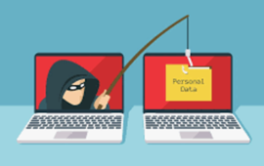
Email Phishing
What is Phishing
Broadly speaking, phishing attack is when a threat actor is trying to be someone you know or some well-known organisations trying to deceive you into trying to deluge some sensitive information, and / or, doing some errands or download some malware.
It can be defined into 2 of these board categories:
  Broadcast
    Broadcast, as the name suggest, is whereby the threat actor will do a mass broadcast to see who will be “baited” by the phishing attack. Normally, the attacker does not have any specific targets to attack.
  Intentional
    Intentional phishing attack is whereby the threat actor have some specific person or organisation to tackle. The attacker with ill-intention, will try all means to attack that specific organisation.

Slide 6

Email Phishing
What is email phishing and how to spot a phishing email

Slide 7
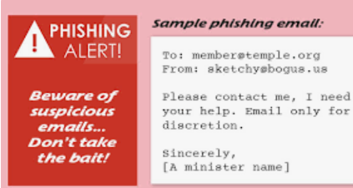
Email Phishing
Phishing email is email send from threat actor acting as someone that you know requesting you to perform some tasks with malicious intent or deceive you to provide the attacker exploitable information (like bank account login credentials, for example) or access to your mobile device.
  They will entice you to open the attachment or clicking on the link by exhibiting subject lines, names that you are familiar with
  They send the email with the intention of collecting personal or confidential information; and/or;
  to load a malicious software into your computer; and/or
  ask you to run some errands, etc..
Once you open the attachment, or clicking on the link, malicious software will install on your computer.

Slide 8
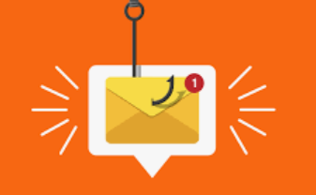
Email Phishing
In light of recent developments, including AI-driven phishing campaigns, it's crucial to stay vigilant. Here are updated guidelines to help protect yourself:
1. Avoid Opening or Downloading Attachments from Unknown Sources
Attachments can harbor malware or ransomware. Even if the email appears legitimate, refrain from opening attachments unless you're certain of their safety.
2. Verify the Sender's Identity
If an email claims to be from a known organization or individual but seems suspicious, contact them directly through official channels to confirm its authenticity.
3. Exercise Caution with Links in Emails
Hover your mouse pointer over links to preview their destination. Be wary if the URL doesn't match the sender's domain or seems unusual. AI-generated emails can closely mimic legitimate communications, making it harder to spot fraudulent links

Slide 9
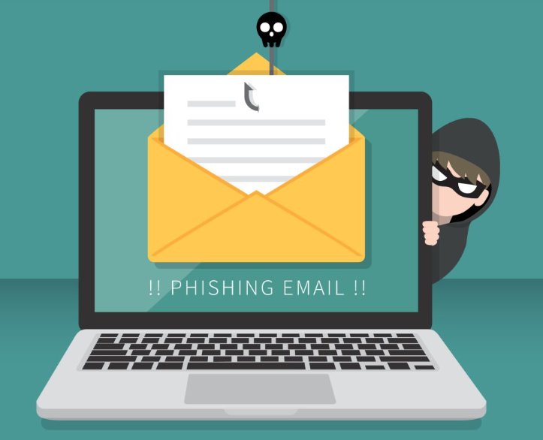
Email Phishing
4. Avoid Responding to Unsolicited Emails
Refrain from replying to emails from unknown senders. Scammers often use responses to gather more information about you.
5. Do Not Make Purchases or Donations via Email Requests
Legitimate organizations typically don't ask for donations or purchases through unsolicited emails. Verify such requests through official websites or contact points.
6. Report Suspicious Emails
Use the “Phish Alert Report” feature in Outlook to report phishing attempts. Prompt reporting helps protect others and improves detection systems.
7. Enable Two-Factor Authentication (2FA)
Adding an extra layer of security, such as 2FA, can prevent unauthorized access even if your password is compromised .

Slide 10
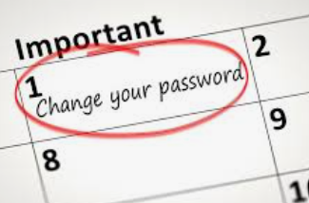
Email Phishing
8. Regularly Update Passwords
Use strong, unique passwords for each account and update them periodically. Consider using a password manager to keep track of them securely.
9. Be Cautious of Urgent Language
Phishing emails often create a sense of urgency, prompting quick action. Be skeptical of messages that pressure you to act immediately .
10. Educate Yourself and Others
Stay informed about the latest phishing tactics and share this knowledge with friends and colleagues to enhance collective security.
By adhering to these practices, you can significantly reduce the risk of falling victim to phishing attacks, especially those enhanced by AI technologies. Stay vigilant and prioritize your online security.

Slide 11
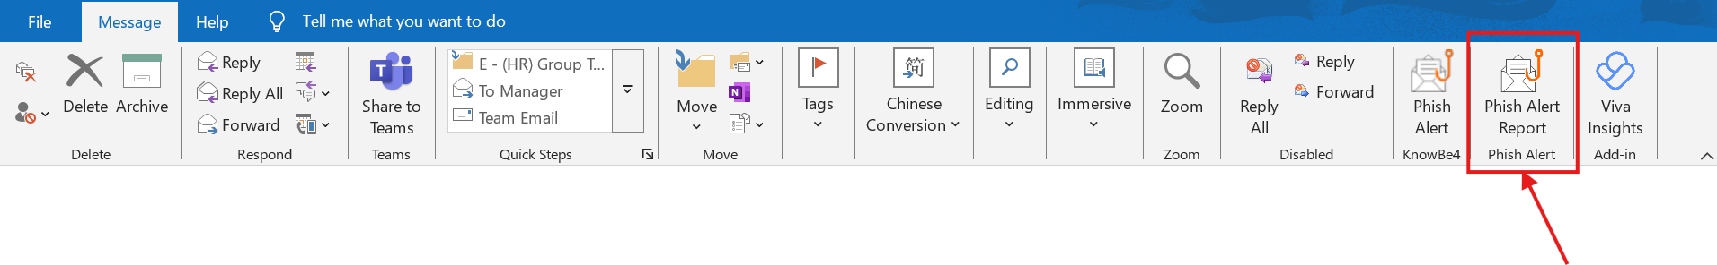
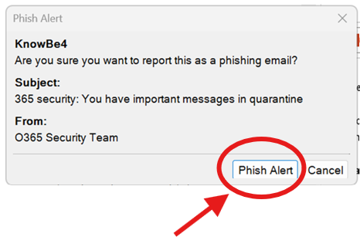
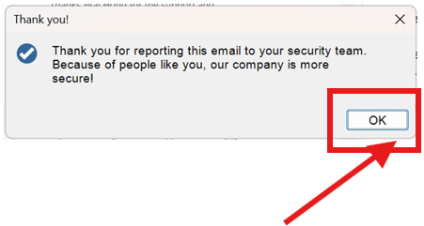
Email Phishing
How to report a Phishing Email
Step 1: Click on Phish Alert Report Button
Step 2: Click on Phish Alert Button
Step 3: Click OK

Slide 12
What we learnt
Phishing attack is when a cyber criminal is trying to be someone you know or some well-known organisations trying to deceive you into trying to deluge some sensitive information, and / or, doing some errands or download some malware.
Phishing email is email send from cyber criminal acting as someone that you know requesting you to perform some tasks with malicious intent.
How to use PAB to report phishing emails

Slide 13
What we learnt
Do | Do Not
Verify the Sender's Identity using official channels | Do not open or download attachments from unknown sources
Exercise caution with links in emails and hover your mouse pointer over links to preview their destination. | Do not respond to unsolicited emails
Report suspicious emails using PAB functions | Do not make purchases or donations via unsolicited email requests
Enable Two-Factor Authentication (2FA) to prevent unauthorized access whenever possible
Use strong, unique passwords for each account and regularly update passwords
Report to DSS if you suspect your email account have been compromised

Slide 14
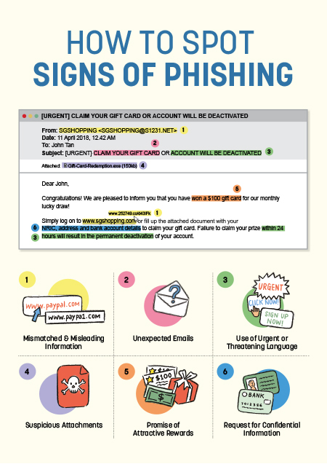
Email Phishing
Don’t Take the Bait — Learn the Signs of Phishing!

Slide 15
Call Phishing

Slide 16
Call Phishing
Vishing (short for "voice phishing") is when a scammer tries to trick you over the phone into giving away personal or sensitive information—like passwords, bank details, or one-time PINs.
They often pretend to be someone you trust, such as a bank officer, government official, or company IT support. Their goal is to sound convincing and pressure you into acting quickly.
Most usual techniques is to impersonate someone with authority and request a money transfer or pay a fraudulent invoice, prompting employees to comply with the requests.
Example: You get a call from someone claiming there's a problem with your bank account, and they ask for your OTP to “verify” your identity. If you give it to them, they could steal your money.

Slide 17
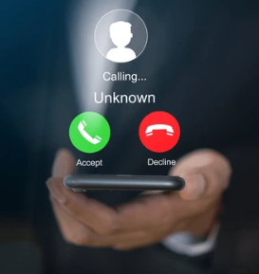
Call Phishing
🚨 Stay Alert: Protect Yourself from Phone Scams
Don’t trust a call just because the caller sounds familiar. Fraudsters can impersonate people you know.
Always verify the caller’s identity through a separate, trusted communication channel before taking any action.
Be suspicious if the caller asks for:
  Sensitive personal information
  Passwords or one-time PINs
  Money transfers or account access

Slide 18
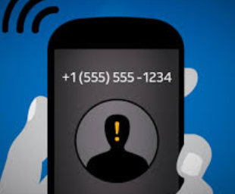
Call Phishing
Reject calls from unknown numbers—especially those starting with a “+” or from international numbers you don’t recognize.
Government agencies and banks will never call you to request personal details or money transfers.
Scammers often pose as officials to trick you into sharing information.

Slide 19

SCAMSHIELD
ScamShield is a suite of tools designed to protect individuals and the community from scams. It includes:
  ScamShield App: Identifies and flags suspicious incoming calls and SMS messages. Users can also report scam-related numbers and messages, contributing to national scam prevention efforts.
  ScamShield Website: Offers up-to-date resources on scam trends, red flag alerts, and monthly scam statistics to help raise awareness and promote vigilance.
  ScamShield Helpline (1799): Provides immediate assistance and can connect scam victims to their respective banks for urgent action.
  ScamShield Alerts via WhatsApp: Delivers real-time scam updates and alerts directly to users through verified social channels.

Slide 20
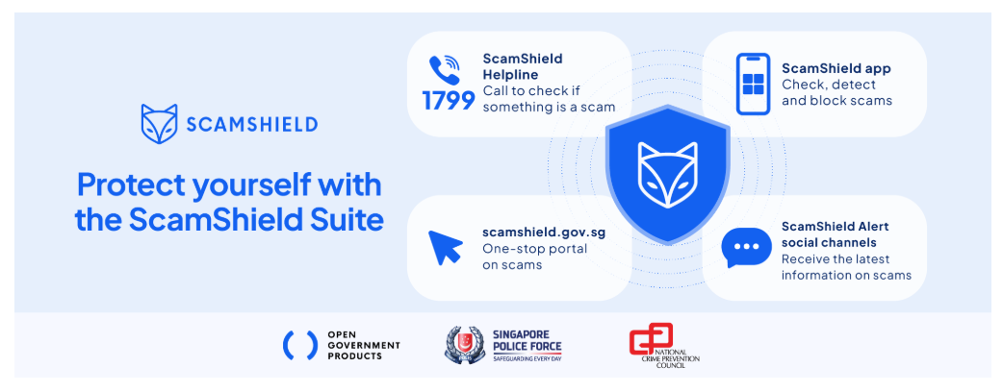
SCAMSHIELD
Download ScamShield from Google Play for android phones or App store for IOS users

Slide 21
What we learnt
Vishing, also known as call phishing or voice phishing, is the art of making phone calls or leaving voice messages purporting to be from reputable companies in order to trick individuals to reveal personal information, such as bank details and credit card numbers.
Do | Do Not
Always verify the caller’s identity through a separate, trusted communication channel before taking any action. | Do not trust a call just because the caller sounds familiar or knows you
Be suspicious if the caller asks for - Sensitive personal information - Passwords or one-time PINs - Money transfers or account access | Do not accept call from unknown numbers, especially from foreign and international numbers.
 | Do not share personal information or money transfers over the phone

Slide 22

Call Phishing

Slide 23
Phishing QR Code

Slide 24
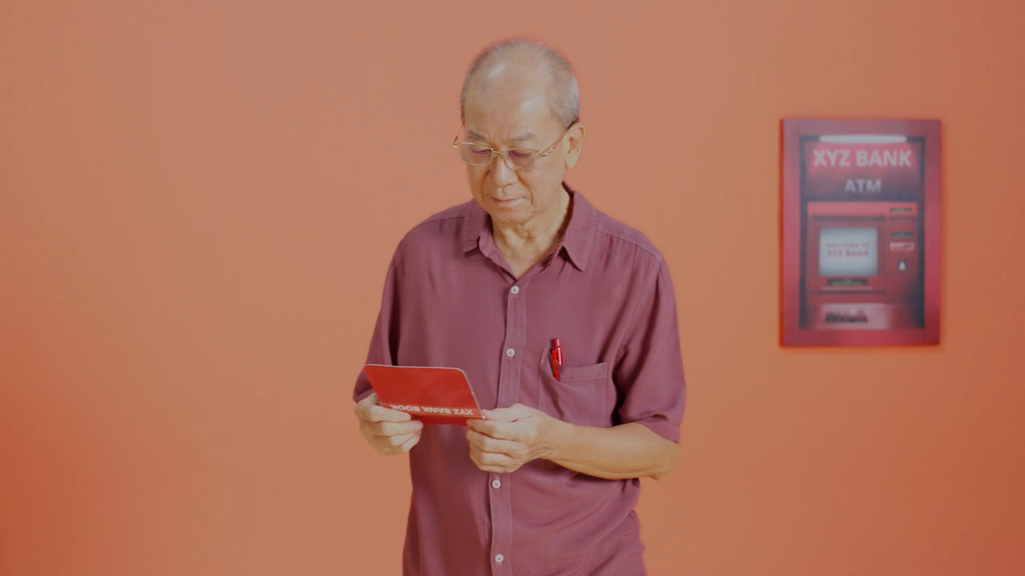
Phishing QR Code
Spot Signs of Phishing

Slide 25
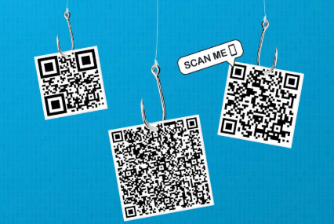
Phishing QR Code
⚠️ QR Codes: The New Face of Phishing
QR codes are now being used by scammers, just like fake emails.
They look harmless and are found everywhere such as in cafés, on TV, in emails, and on social media which making it easy for fake ones to go unnoticed.
The main danger is that you can’t tell where a QR code will take you until you scan it, which could lead you straight to a scam or harmful site.
Always verify the source before scanning a QR code.

Slide 26
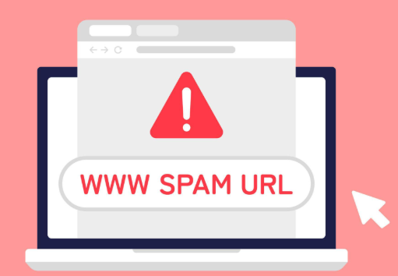
Phishing QR Code
🔍 Stay Smart When Scanning QR Codes
Inspect the Web Address Carefully
Before scanning any QR code, examine the URL it leads to. Most smartphones offer a preview of the link.
  If the URL looks suspicious, contains spelling errors, or doesn’t start with “https://”, do not tap.
Avoid links that appear shortened or obscure (e.g., bit.ly links), unless you fully trust the source.
Don’t Interact with Suspicious Pages
If you accidentally open a malicious QR code:
    Do not enter personal or login information.
    Avoid downloading any files that begin automatically.
    Close the page immediately.

Slide 27
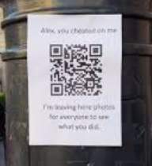
Phishing QR Code
Verify QR Codes in Public Places
If you're at a business, ask a staff member to confirm the code's legitimacy.
Be cautious even with confirmed codes—fraudsters often place fake QR stickers over real ones.
Watch for Odd Placement
QR codes found in unusual locations (like random stickers on walls or lamp posts) could be phishing traps.

Slide 28
What we learnt
QR codes scam is similar to phishing emails. They are almost everywhere and there is no way to tell if the QR code is legitimate until you have scan it
Do | Do Not
Always verify the source before scanning a QR code and inspect the web address carefully | Do not interact with suspicious pages
Verify QR codes in public places with the staffs | Do not scan any QR code located at any odd placement like lamp post, ramdom stickers on the walls, etc.

Slide 29

Phishing QR Code
Don’t Trust Every QR Code —
Think Before You Scan.

Slide 30
Ransomware

Slide 31

Ransomware

Slide 32
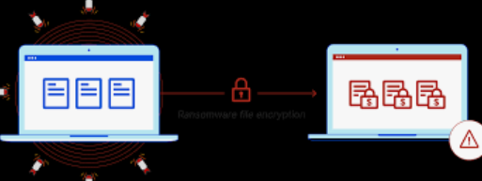
Ransomware
What Is Ransomware?
Ransomware is a type of malicious software (malware) that locks or encrypts your files so you can’t access them. The attackers then demand a ransom—usually in cryptocurrency—in exchange for unlocking your data.
It often spreads through phishing emails, fake websites, or infected attachments. Once inside a computer or network, it can quickly affect important files, causing major disruption.
Ransomware attacks can lead to:
    Loss of access to critical data,
    Financial damage,
    Reputational harm, and
    Business downtime.
Because paying the ransom doesn’t guarantee your files will be recovered, the best defense is prevention. Staying alert, practicing good cybersecurity habits, and reporting suspicious activity are key steps we can all take to protect our organization.

Slide 33
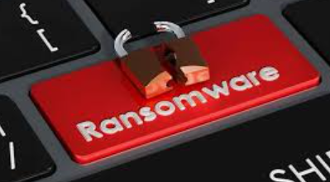
Ransomware
🛠️ What to Do If You're Hit by Ransomware
If you become the victim of a ransomware attack, swift and strategic action is critical. The following steps can help minimize damage and support recovery:
🔒 1. Isolate Infected Systems
  Immediately disconnect affected devices from your network—both wired and wireless.
  This prevents the ransomware from spreading to other systems, servers, or shared storage.
🧹 2. Run Reputable Antimalware Tools
  Use trusted antimalware or antivirus software to identify and remove the ransomware.
  Ensure your tools are fully updated before running scans on the isolated systems.

Slide 34
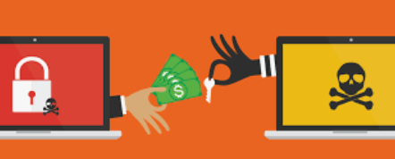
Ransomware
🔓 3. Decrypt or Restore Your Data
  Check if a free decryption tool is available from reputable sources such as law enforcement agencies or cybersecurity organizations (e.g., Cyber Security Agency of Singapore).
  If decryption is not possible, restore data from clean, secure backups taken prior to the attack.
Do not pay the ransom—there is no guarantee you will receive a working decryption key, and it may encourage future attacks.
Report to DSS if you suspect that your laptop have been hit by ransomware
Notes:
Ransomware prevention and protection strategies
Protect your endpoints and clouds
The best form of protection is prevention. Many ransomware attacks can be identified and blocked with a trusted endpoint detection and response solution, such as Microsoft Defender for Endpoint. Extended detection and response (XDR) solutions, like Microsoft Defender XDR, go beyond endpoint protection to help you secure your devices, email, collaboration apps, and identities. And with so much business conducted in the cloud, it’s important to protect all your cloud infrastructure and apps with a solution like Microsoft Defender for Cloud
Hold regular trainings
Keep employees informed about how to spot the signs of phishing and other ransomware attacks with regular trainings. To reinforce learnings and identify opportunities for additional training, follow up with periodic phishing simulations. This will help your employees learn safer practices for work and also how to be safer when using their personal devices.
Adopt a Zero Trust model
A Zero Trust model assumes that every access request, even those coming from inside the network, is a potential threat. Zero Trust principles include verifying explicitly through continuous authentication, enforcing least-privilege access to minimize permissions, and assuming breach by implementing strong containment and monitoring measures. This extra scrutiny decreases the likelihood that a malicious identity or device will access resources and install ransomware.
Join an information-sharing group
Information-sharing groups, frequently organized by industry or geographic location, encourage similarly structured organizations to work together toward cybersecurity solutions. The groups also offer organizations different benefits, such as incident response and digital forensics services, threat intelligence, and monitoring of public IP ranges and domains.
Maintain offline backups
Because some ransomware will try to seek out and delete any online backups you might have, it’s a good idea to keep an updated offline backup of sensitive data that you regularly test to make sure it’s restorable if you’re ever hit by a ransomware attack.
Keep software up to date
In addition to keeping any antimalware solutions updated, be sure to download and install any other system updates and software patches as soon as they’re available. This helps minimize any security vulnerabilities that a cybercriminal might exploit to gain access to your network or devices.
Create an incident response plan
An incident response plan will provide you with steps to take in different attack scenarios so that you can get back to operating normally and safely as soon as possible.

Slide 35
Password Safety

Slide 36
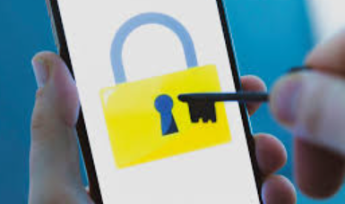
Password Safety
Passwords: Your First Line of Cyber Defense
Passwords are the primary barrier protecting your devices, applications, and sensitive data from unauthorized access. Implementing strong password security is essential to safeguarding both personal and organizational information from cyber threats such as hacking, identity theft, and data breaches.
Weak, reused, or easily guessed passwords are highly vulnerable to common attack methods like phishing, brute-force attempts, and credential stuffing. To reduce these risks, it is vital for all employees to create strong, unique passwords for each account and adhere to established password management best practices.
By consistently applying good password hygiene, every individual plays a crucial role in strengthening the organization's overall cybersecurity posture.

Slide 37
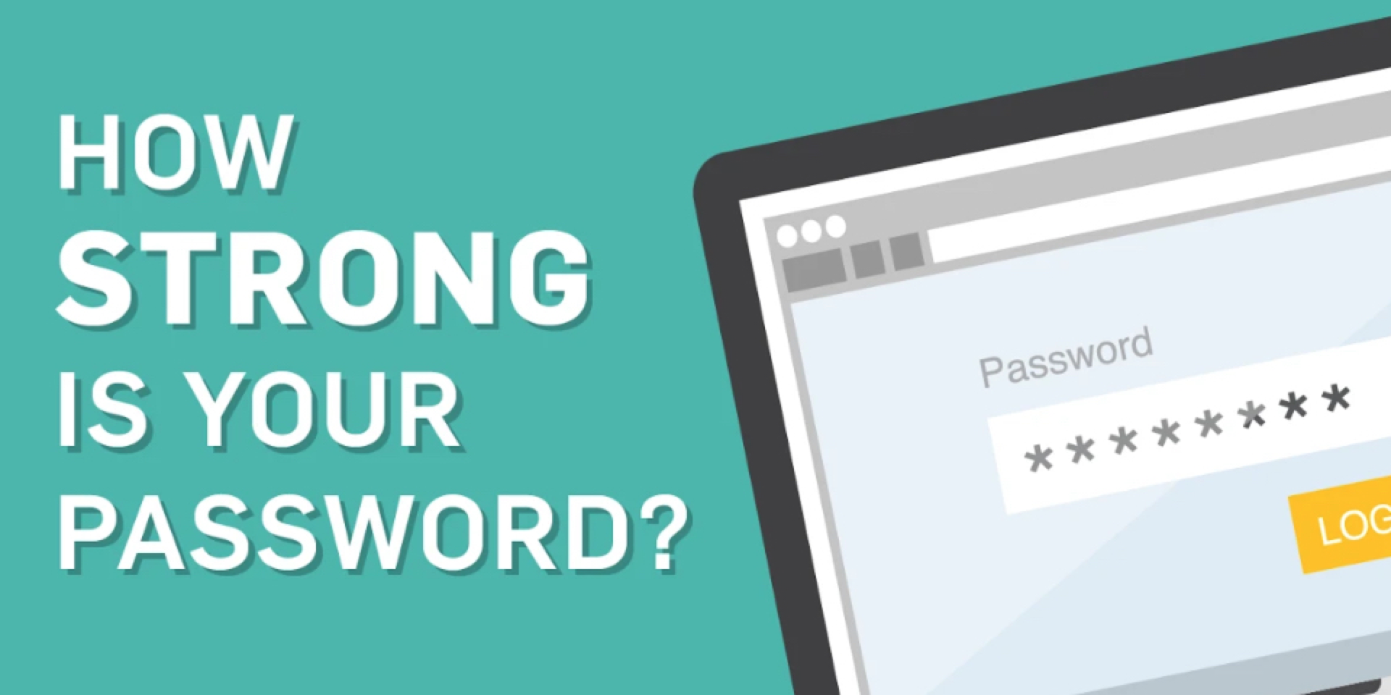
Password Safety
✅ Password Best Practices: Dos and Don’ts
✅ Dos
  Create Strong, Complex Passwords
  Use passwords that are at least 10 characters long and include:
    At least one uppercase letter (A–Z)
    At least one lowercase letter (a–z)
    At least one number (0–9)
    At least one special character (e.g., @, #, _, -)
  Use Unique Passwords for Each Account
  Avoid using the same password across multiple services. This limits the damage if one account is compromised.
  Start Fresh When Resetting
  Always create a new password when prompted to reset—never reuse old passwords.

Slide 38
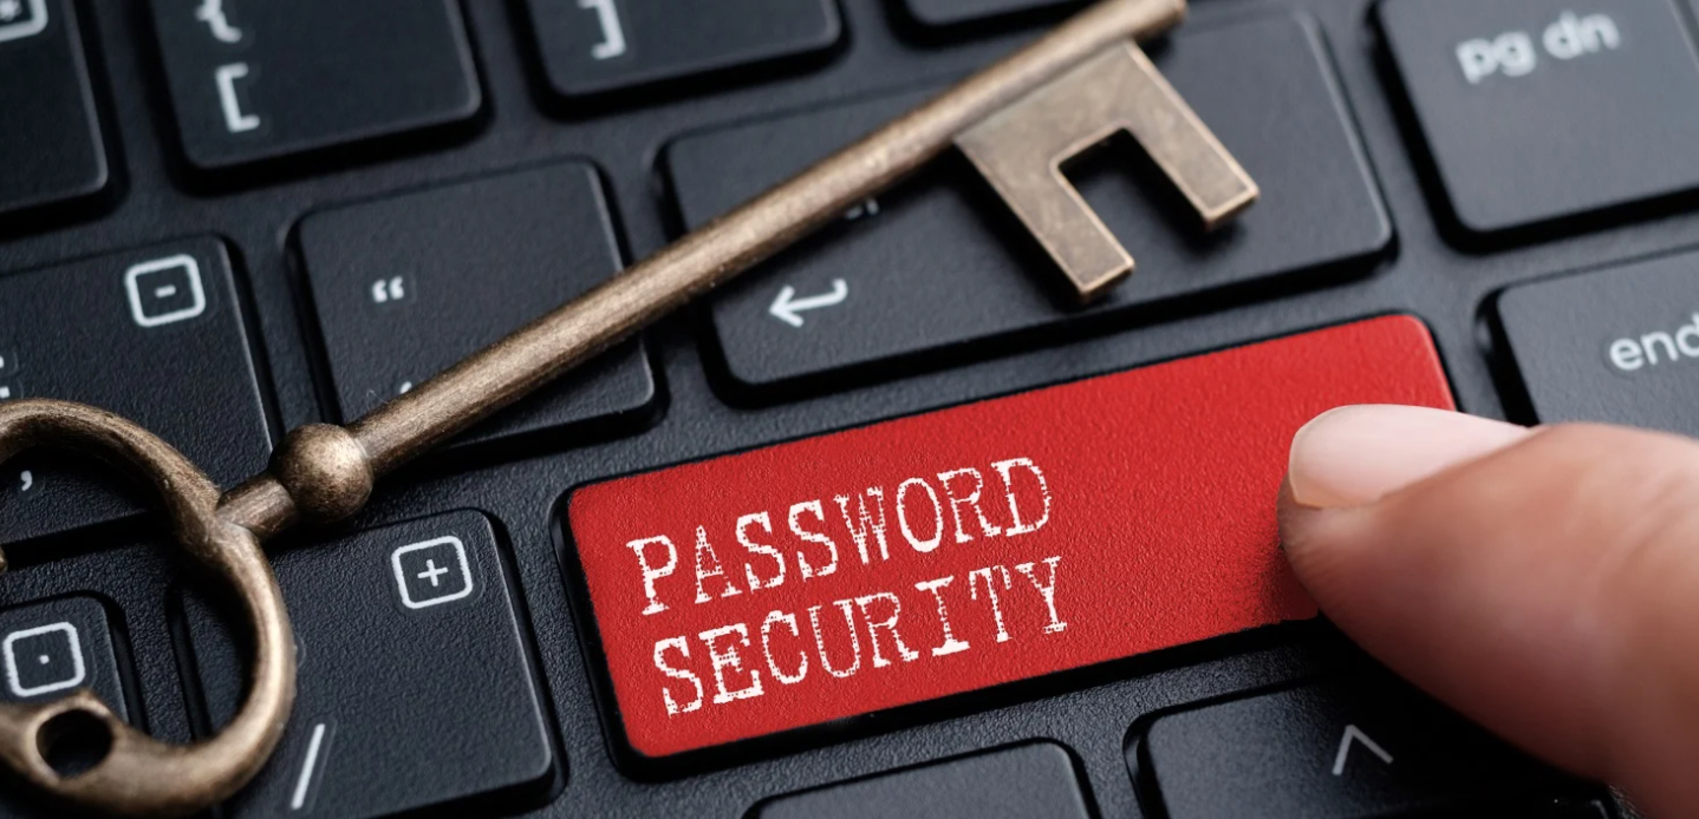
Password Safety
✅ Password Best Practices: Dos and Don’ts
❌ Don’ts
Don't Use Personal Information as password
Avoid passwords that include easily guessed details such as your name, birthdate, NRIC number, or phone number.
Don't Reuse Passwords
Reusing passwords across accounts increases the risk of a single breach leading to multiple account compromises.
Don't Use Simple or Common Passwords
Avoid weak passwords like 123456, password, or qwerty, as these are commonly targeted in attacks.

Slide 39
What we learnt
The good practices for password security
Do | Do Not
Create strong and complex passwords | Never reuse old passwords
Use unique passwords for each accounts | Do not use the same password across multiple accounts
Always create a new password when prompted to reset | Do not use personal information as password
Use passwords that are at least 10 characters long and include: - At least one uppercase letter (A–Z) - At least one lowercase letter (a–z) - At least one number (0–9) - At least one special character (e.g., @, #, _, -) | Do not Use Simple or Common Passwords

Slide 40
Password Safety
How to create a strong password?

Slide 41
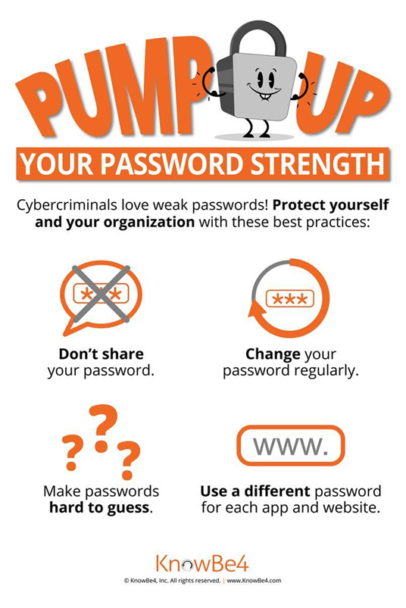
Password Safety
Use Strong, Unique Passwords for Every Account.

Slide 42
Our IT Policies

Slide 43
Our IT Policies
Personal Computers and Other Computing Devices
    Laptops/ desktops must have proper anti-virus software installed with anti-virus signatures updated on a regular basis.
    Laptops/ desktops can be used only after logged in with unique user account ID and password.
    Devices must be properly secured, and screen locked when left unattended (e.g., during lunch time, toilet break).

Slide 44
Our IT Policies
Personal Computers and Other Computing Devices
    All new software installation should have the installer acquired from legitimate source. This to avoid any copyright violations and prevent malware intrusions into the company network.
    Full disk encryption must be used on hard disk of portable computers (such as notebook computers) and removable storage media.
    Storing of confidential data in USB devices or cloud storages should be avoided. If need to, the data/documents must be protected with encryption or minimally, passwords.

Slide 45
Our IT Policies
Printer/Copier/Fax
    Collect print outs and faxes as soon as they are printed.
    Use Secure Print to print confidential and secret documents on common shared printers.
    Remove (return to owner or destroy) any uncollected printouts and faxes promptly.

Slide 46
Our IT Policies
Network Usage
    Network usage is granted for the sole purpose of supporting business activities necessary to carry out job functions.
    Great care must be taken when downloading files from websites. All downloaded files must be scanned using anti-virus software before use.

Slide 47
Our IT Policies
Email Usage
    Ensure all personal data or sensitive information and files to be sent is correct, relevant, and secure when sending, and these data/files must be protected with encryption.
    Company email accounts are to be primarily used for business related purposes.
    Auto forwarding of company emails to any addresses other than those used by the company is prohibited.

Slide 48
Our IT Policies
Company issued IDs / passwords ensure that only authorised employees can access company resources.
User accounts must not be shared.
Employees are required to create a strong password containing at least 10 alphanumeric characters that meets the defined complexity requirements. A password is considered complex if it is made up of at least one character from all of the following 4 groups:
    digits (0 to 9),
    b) uppercase alphabets,
    c) lowercase alphabets, and
    d) special character (e.g., @ or &).
All user account creation and changes of permission must be approved by the relevant Heads of Department (HODs).
Avoid using the same password for different accounts.

Slide 49
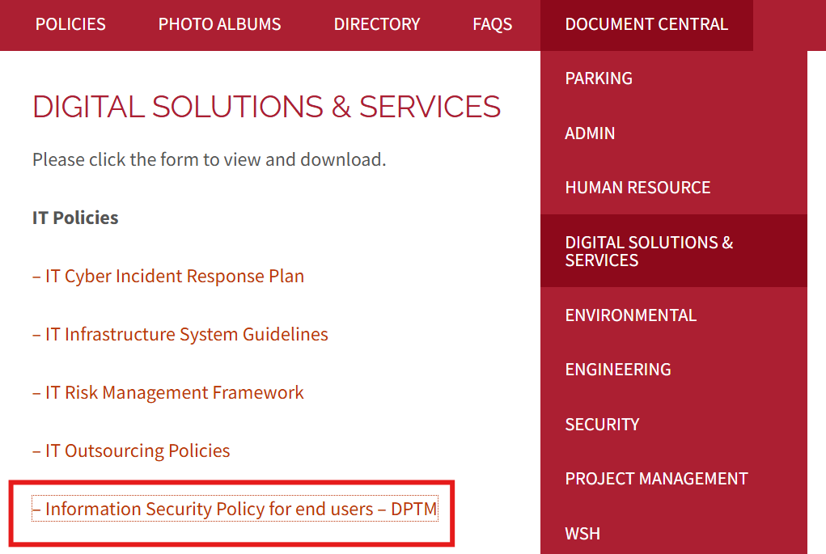
Our IT Policies
Please refer to our intranet for the most up-to-date information.
You can access it via our intranet or through the following link:
https://intranet.cbm.com.sg/wp-content/uploads/Information-Security-Policy-for-end-users-DPTM-30th-May-2025.pdf

Slide 50
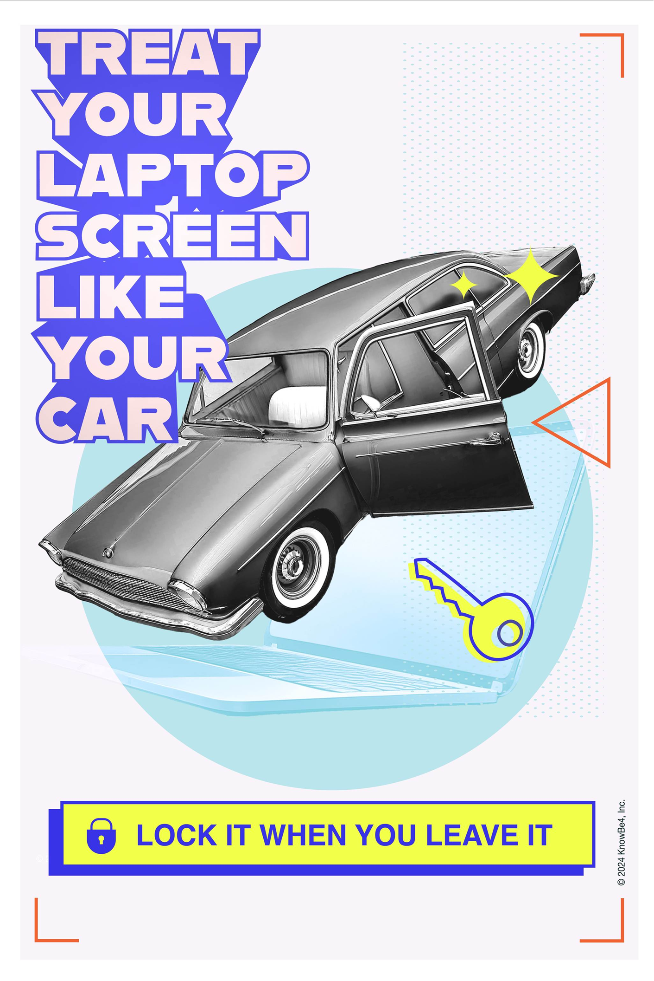
Our IT Policies
Step Away?
Lock It First — Just Like Your Car.

Slide 51
Device Management

Slide 52
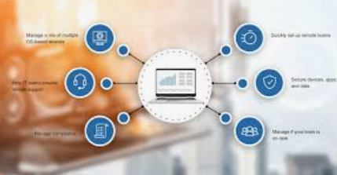
Device Management
What Is Device Management and Why It Matters
Device management means taking care of all the work devices we use—like laptops, desktops, phones, and tablets—to make sure they are safe, up to date, and working properly.
As more people work remotely and use mobile or cloud tools, it's more important than ever to make sure that every device connected to our company network is protected. If a device isn't secure, it could lead to problems like data leaks, hacking, or viruses.
You can help by:
  Keeping your device’s software updated,
  Only using apps approved by the company,
  Turning on security features like screen locks and encryption, and
  Reporting right away if your device is lost or stolen.
By taking these steps, you help keep company data safe and make sure we all work in a secure environment.

Slide 53
Device Management
Device Security Best Practices
Lock your screen whenever you step away from your computer, even briefly. Regularly check the back of your device for any unfamiliar or unauthorized USB devices.
Never leave passwords written on sticky notes near your workstation. Use a secure password manager instead.
If your device is lost or stolen, immediately change the passwords for all your accounts and report the incident to your IT or security team.
When traveling, avoid leaving your devices unattended in hotel rooms. Use a safe or carry them with you whenever possible.
Download applications only from official company websites or verified sources, rather than relying on general app store searches that may lead to malicious or fake versions.

Slide 54
Device Management
Mobile & WiFi Security Tips
Be cautious of lookalike apps — Not every app in the App Store is legitimate, even if it appears official. Always verify the developer and read reviews before downloading.
Limit app permissions — Apps and widgets often request access to more data than they need. Only grant permissions that are essential for the app’s functionality.
Verify public Wi-Fi networks — When connecting to public Wi-Fi, confirm the exact network name with the business offering it to avoid falling victim to spoofed networks.
Avoid sensitive transactions on public Wi-Fi — Refrain from activities like online banking, entering credit card details, or accessing confidential work information while on unsecured public networks.

Slide 55
Device Management
How to Choose An Anti-Virus Software and Enable Automatic Software Updates?

Slide 56
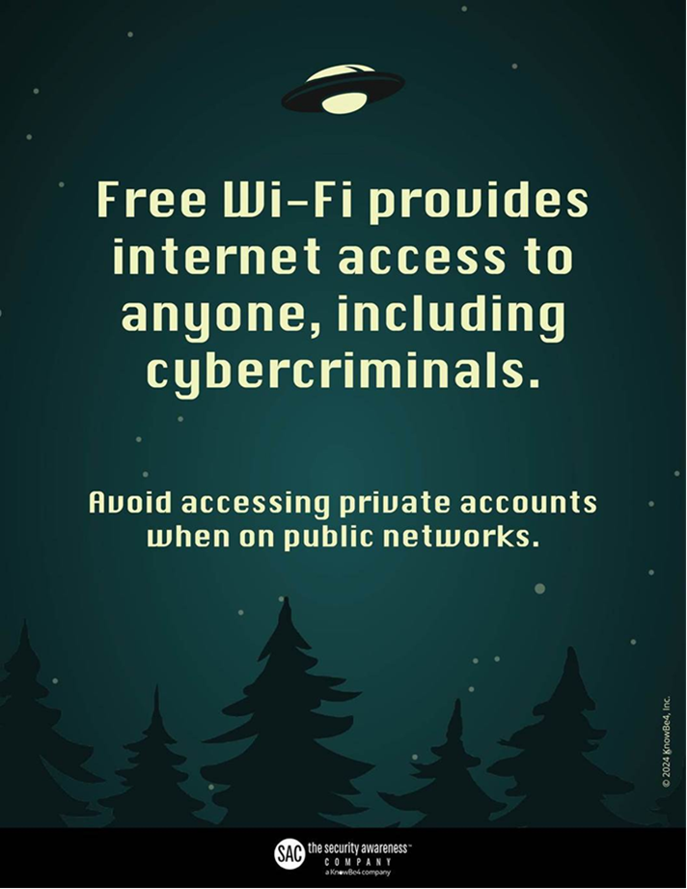
Device Management
Secure Data Begins with Secure Connections — Avoid Sensitive Transactions on Public Wi-Fi.

Slide 57
Data Management

Slide 58

Data Management
What Is Data Management and Why It’s Important
Data management is about taking care of important information—like employee records, customer details, financial reports, and business files—so it’s correct, safe, and easy to find when needed.
As we rely more on digital information, it’s important to manage our data properly to avoid mistakes, stay in line with privacy rules, and prevent data leaks or loss.
    Everyone has a role to play. You can help by:
    Saving files only in secure, approved places,
    Sharing information only through official, safe channels,
    Protecting sensitive data with passwords or encryption, and
    Deleting files safely when they’re no longer needed.
By handling data the right way, we keep our company running smoothly, protect people’s privacy, and build trust.

Slide 59
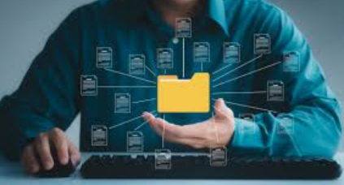
Data Management
Best Practices for Handling Sensitive Information
Always verify any request to update bank account or contact information, regardless of the sender or recipient (e.g., vendors, employees, partners). Use a trusted secondary communication channel to confirm authenticity.
Use only approved, encrypted communication tools for sharing regulated or sensitive data. Avoid using unapproved apps or unsecured methods.
Never store passwords in plain text (e.g., spreadsheets, documents). Use a corporate-approved password manager to securely store and manage credentials.
Refrain from storing personal or sensitive data on portable devices such as USB drives. If absolutely necessary, ensure the device is encrypted and approved by your IT/security team.

Slide 60

Data Management
Handling Sensitive Documents and Data Securely
Do not leave sensitive documents unattended in shared or open office areas. Always store them in a locked drawer, cabinet, or other secured location when not in use.
Retrieve printouts containing confidential information promptly, and securely dispose of them using approved shredding or destruction methods once they are no longer needed.
Avoid including personal or sensitive client information in the body of an email unless it has been properly encrypted and approved for transmission.
Always verify the recipient's contact details before sending sensitive information. Confirm the email address or number using a trusted source, and consider calling the recipient in advance using a verified contact method.
Maintain an offline backup of important data by saving it to designated secure storage such as the Q: drive, in accordance with organizational data backup policies.

Slide 61
What We Have Learnt Today

Slide 62
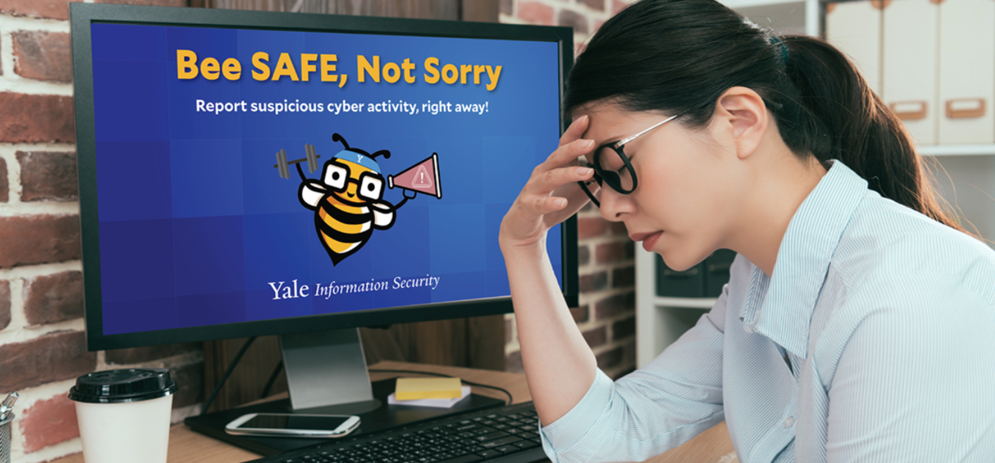
What We Have Learnt Today
Phishing
Definition of phishing.
Email Phishing
What is email phishing and how we can protect ourselves from email phishing.
How to report phishing emails using PAB.
Call Phishing
What is Vishing and how we can protect ourselves against it.
What is SCAMSHEILD is.
Phishing QR Code
What is QR code phishing and how we can protect ourselves from QR code scam.
Ransomware
What is ransomware and what to do if we hit by ransomware.

Slide 63

What We Have Learnt Today
Password Safety
What is the best practices for password security.
Our IT Policies
What are our IT Security policies and where to find the latest copy of IT Security policies.
Device Management
How to protect your devices and the best practices to protect your devices.
Data Management
The importance of data management and how to handle sensitive information.
Report to DSS for any Cyber security related matters

Slide 64
The End
Any Questions?

